Slide 1
Linear Regression
-LKM

Slide 2
Course Agenda :
1
Introduction
2
Introduction to Predictive Life Cycle
3
Linear Regression
4
R- Use Case
5
Python – Use Case
6
End
Notes:
Key Message(s):
Review the Agenda.
Additional Information:
This is just a brief reminder of where you are in the course. It will also help participants to know what is coming up.

Slide 3
Introduction
Linear regression - Introduction

Slide 4
Question
Sold my Kidney
Cost of Mobile phone
Bought Free
Jio phone
Low
High
Likelihood of cracking the screen

Slide 5
Question 2
9 AM
Missed Shuttle
Missed Bath
Daily wake up time
Missed Breakfast
Missed Exercise
5 AM
Low
High
Repent graph

Slide 6
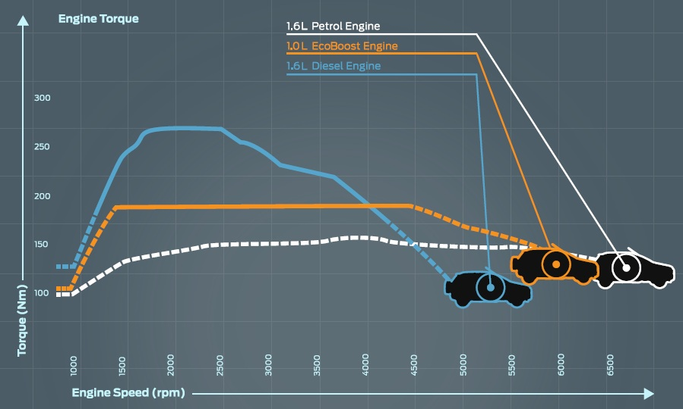
Example:

Slide 7

Example:
A “used” car dealer of Maruti Swift on Bannerghatta road believes that the odometer reading does have an effect on the sales price.
What is the precise nature of the relationship?

Slide 8
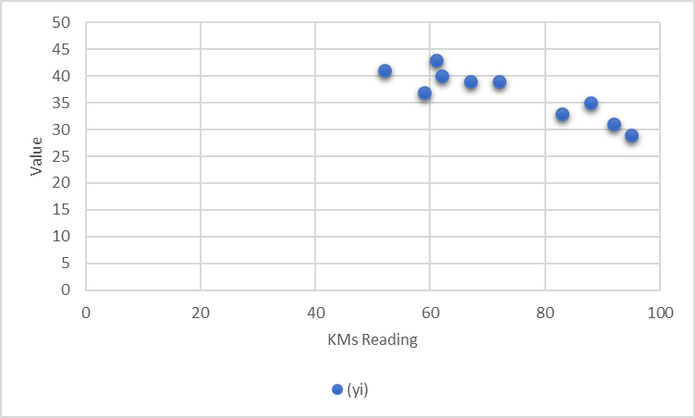
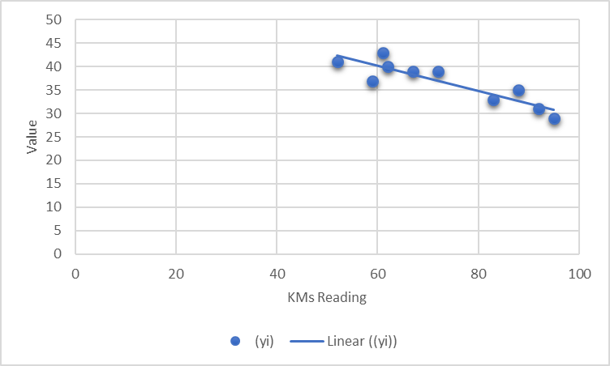
Sample Data:
CAR | READING (1000 kms) | VALUE (in Rs 10000)
 | (x_{i}) | (y_{i})
1 | 59 | 37
2 | 92 | 31
3 | 61 | 43
4 | 72 | 39
5 | 52 | 41
6 | 67 | 39
7 | 88 | 35
8 | 62 | 40
9 | 95 | 29
10 | 83 | 33

Slide 9
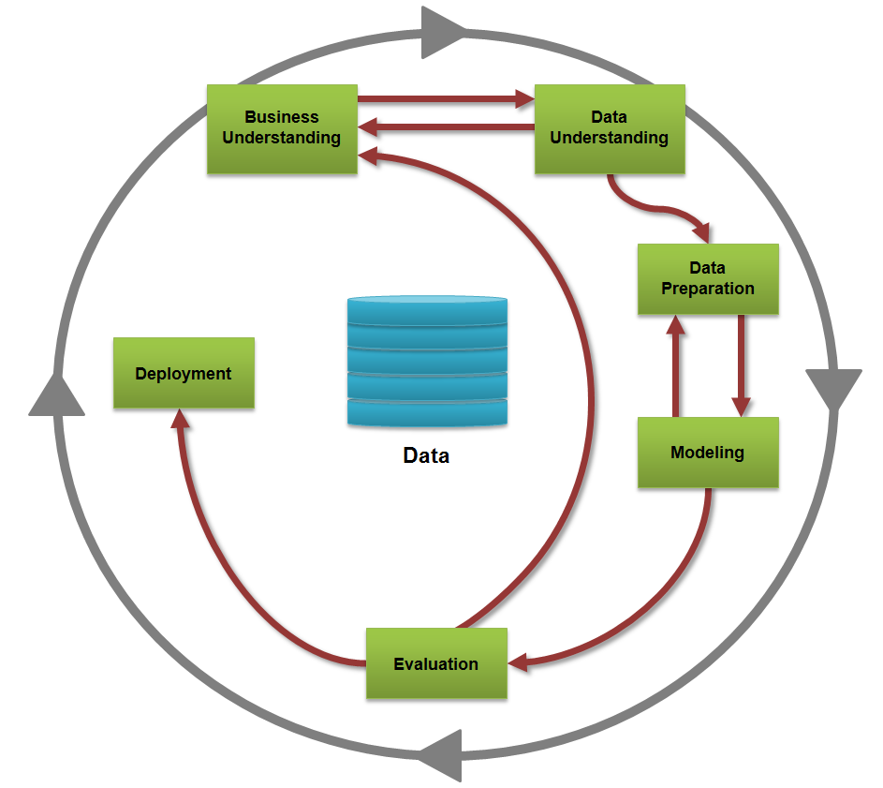
Predictive Analytics - Life Cycle

Slide 10
Motivation
7
If decision makers can determine how the known is related to the future event, they can add the decision making process considerably.
How do we determine the relationship between variables?

Slide 11
Linear Regression
Linear Regression is one of the easiest algorithms in machine learning.
As the name suggests this algorithm is applicable for Regression problems
Linear Regression is a Linear Model. Which means, we will establish a linear relationship between the input variables(X) and single output variable(Y).
When the input(X) is a single variable this model is called Simple Linear Regression and when there are mutiple input variables(X), it is called Multiple Linear Regression.

Slide 12
The Model
The first order linear model
y = dependent variable
x = independent variable
β₀ = y-intercept
β₁ = slope of the line
ε = error variable
β₀ and β₁ are unknown population parameters, therefore are estimated
from the data.
y
Rise
β₁ = Rise/Run
β₀
Run
x

Slide 13
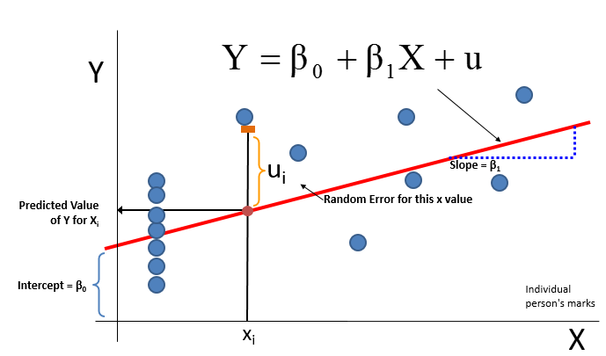
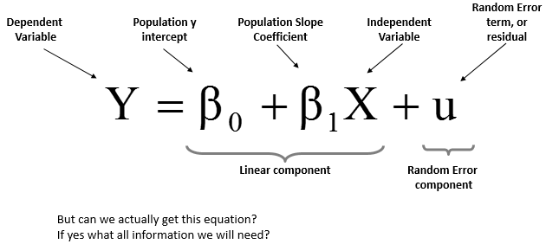
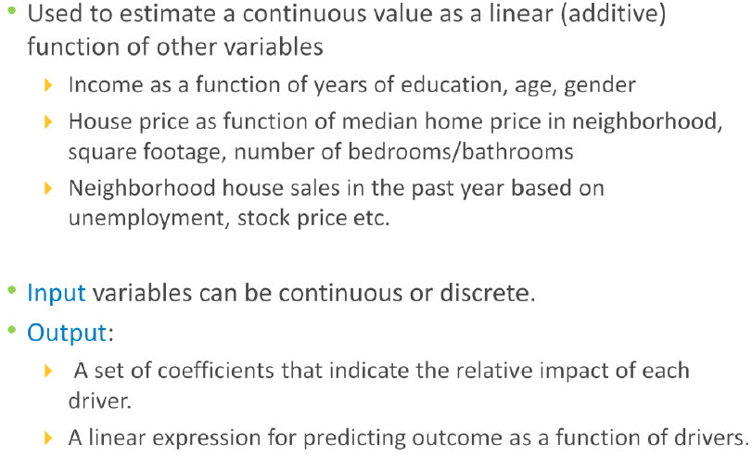
Introduction-Linear Regression
In statistics, linear regression is an approach for modeling the relationship between a scalar dependent variable y and one or more explanatory variables (or independent variables) denoted X. The case of one explanatory variable is called simple linear regression.
Ref : https://en.wikipedia.org/wiki/Linear_regression

Slide 14
Thinking Challenge
How would you draw a line through the points? How do you determine which line ‘fits best’?
Slope changed
Y
60
40
20
0
X
0
20
40
60
Intercept changed
Notes:
45

Slide 15
Estimating the Coefficients
The estimates are determined by
drawing a sample from the population of interest,
calculating sample statistics.
producing a straight line that cuts into the data.
y
w
Question: What should be considered a good line?
w
w
w
w
w w w w
w
w w
w w
w
x

Slide 16
The Least Squares (Regression) Line
A good line is one that minimizes the sum of squared differences between the
points and the line.

Slide 17
The Least Squares (Regression) Line
Sum of squared differences =
(2 - 1)² +
(4 - 2)² +
(1.5 - 3)² +
(3.2 - 4)² = 6.89
Sum of squared differences =
(2 -2.5)² +
(4 - 2.5)² +
(1.5 - 2.5)² +
(3.2 - 2.5)² = 3.99
Let us compare two lines
4
(2,4)
w
The second line is horizontal
3
w
(4,3.2)
2.5
2
w
(1,2)
(3,1.5)
w
The smaller the sum of
squared differences
the better the fit of the
line to the data.
1
1
2
3
4

Slide 18
Least Squares Graphically
Notes:
52

Slide 19
Important Notes
Linear Regression – Details (Few Terminologies before Use Case Discussion)

Slide 20
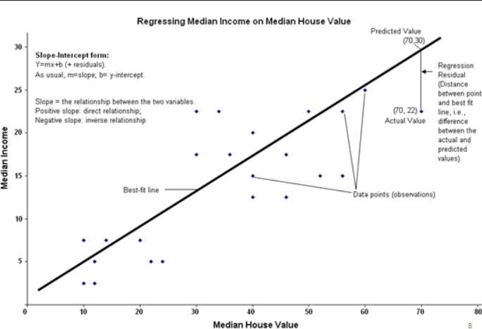
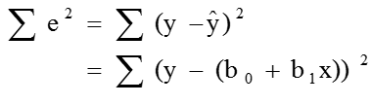
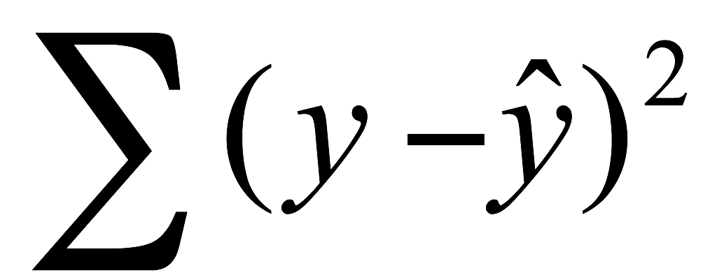
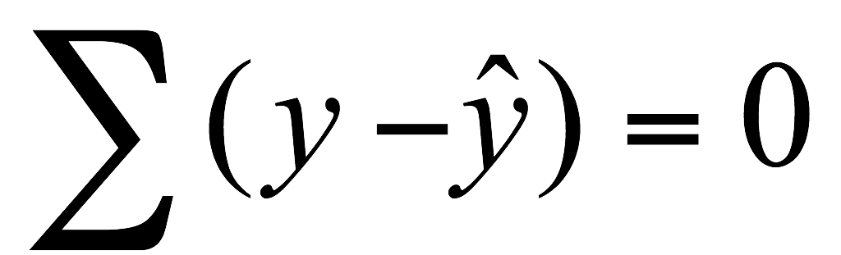
Ordinary Least Square (OLS)
In statistics, ordinary least squares (OLS) or linear least squares is a method for estimating the unknown parameters in a linear regression model, with the goal of minimizing the differences between the observed responses in some arbitrary dataset and the responses predicted by the linear approximation of the data (visually this is seen as the sum of the vertical distances between each data point in the set and the corresponding point on the regression line - the smaller the differences, the better the model fits the data).
b₀ and b₁ are obtained by finding the values of b₀ and b₁ that minimize the sum of the squared residuals
The sum of the squared residuals is a minimum.
Minimize ( )
The sum of the residuals from the least squares regression line is 0.
The least squares coefficients are unbiased estimates of β₀ and β₁
Ref:https://en.wikipedia.org/wiki/Ordinary_least_squares
https://www.google.co.in/search?q=Ordinary+Least+squares+gif&biw=1280&bih=539&tbm=isch&tbo=u&source=univ&sa=X&ved=0ahUKEwiuz5yOpb7LAhUWBY4KHTctCgwQ7AkINg&dpr=1.25#imgrc=TAIKpYAjF1_Q2M%3A

Slide 21
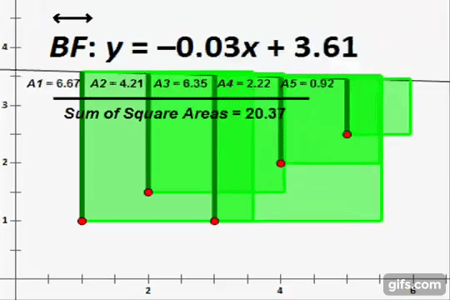

Slide 22
Draw line 1
Error = 2x + x + 2.5x
Error = 5.5x
2.5x
2x
x

Slide 23
Draw line 2
.5x
Error = -(.5x) + (-2x) + (-.5x)
Error = -3x
.5x
2x

Slide 24
Draw line 3
.5x
Error = .5x + (-x) + .5x
Error = 0x
.5x
x

Slide 25
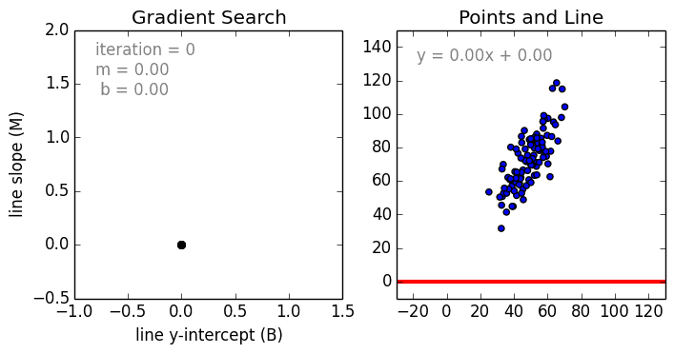
How does it work?
Source: https://raw.githubusercontent.com/mattnedrich/GradientDescentExample/master/gradient_descent_example.gif

Slide 27
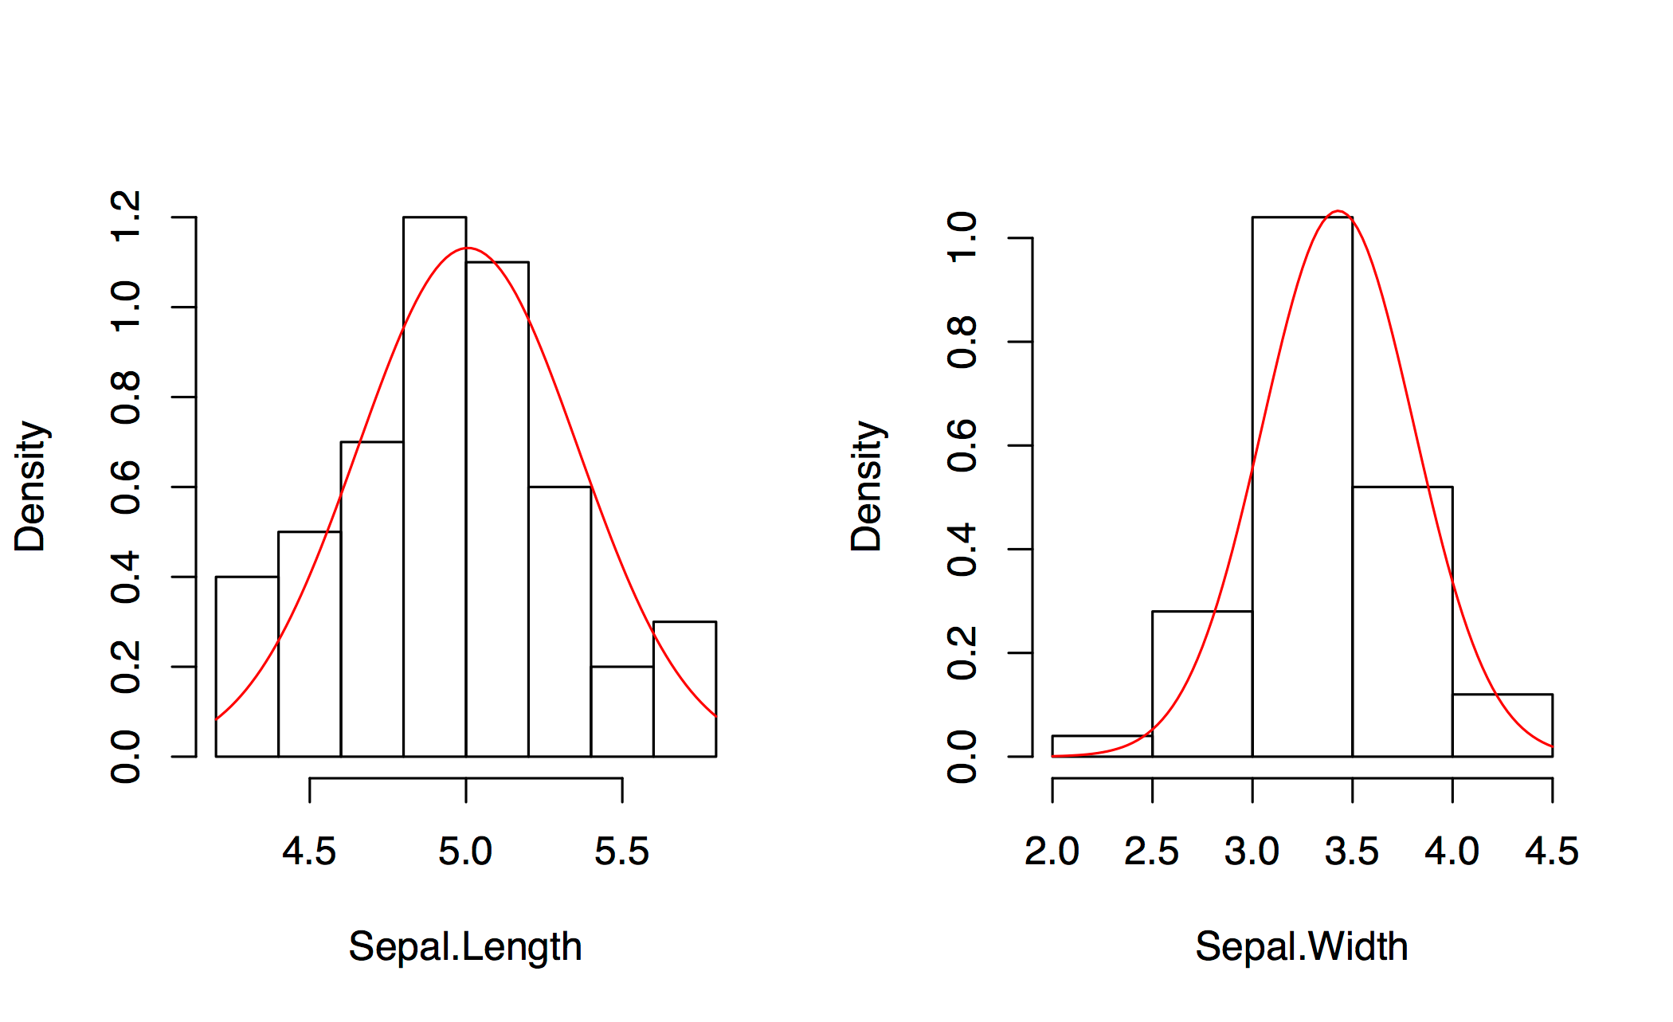
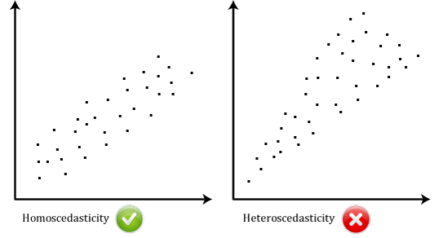
Linear Regression - Assumptions
Summary on Linear regression assumptions:
Linear relationship -the variable and the constant are connected via a straight line
Multivariate normality - set of (possibly) correlated real-valued random variables each of which clusters around a mean value
No or little multicollinearity - the independent variables are not highly correlated with each other. VIF < 2
Homoscedasticity - the variance of error terms are similar across the independent variables
Sl.No# | Topics | Reference | Note
1 | Linear regression - Assumptions | http://www.statisticssolutions.com/assumptions-of-linear-regression/ | Linear Regression – Minimum Requirement

Slide 28
Coefficient of Determination
46
How “useful” is the fit?
How strong is the linear relationship between Y and X?
A measure of ‘Goodness of Fit’.
A measure of strength of prediction.
The coefficient of determination R² is another measure of how well the least square equation y^{ˆ} =b0 +b1x performs as a predictor of y.

Slide 29
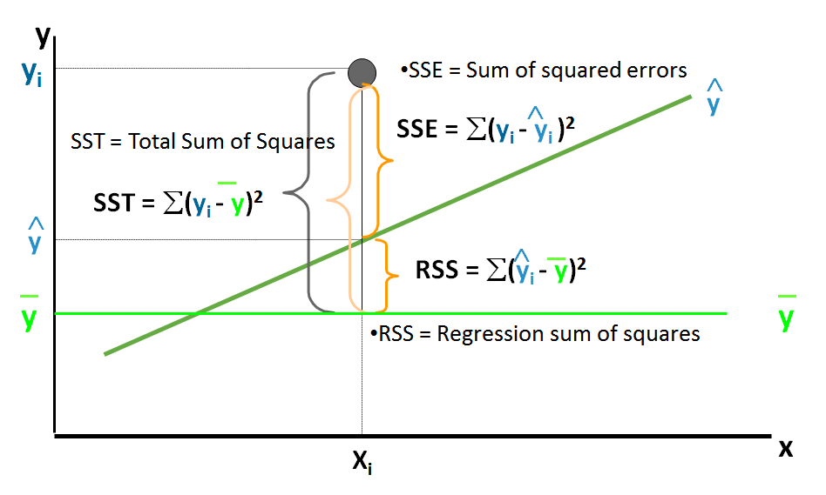
Coefficient of Determination (R²)
SST = Total sum of squares
Measures the variation of the yi values around their mean y
SSE = Sum of squared errors Variation attributable to factors other than the relationship between x and y
SSR = Regression sum of squares Explained variation attributable to the relationship between x and y

Slide 30
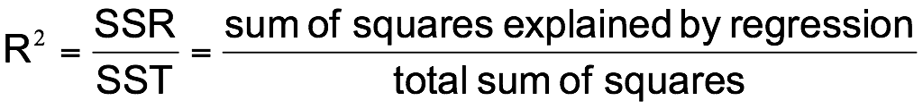
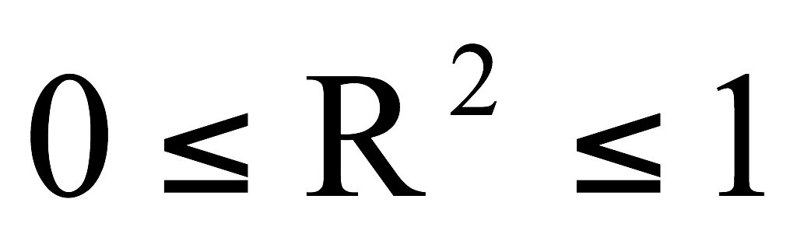
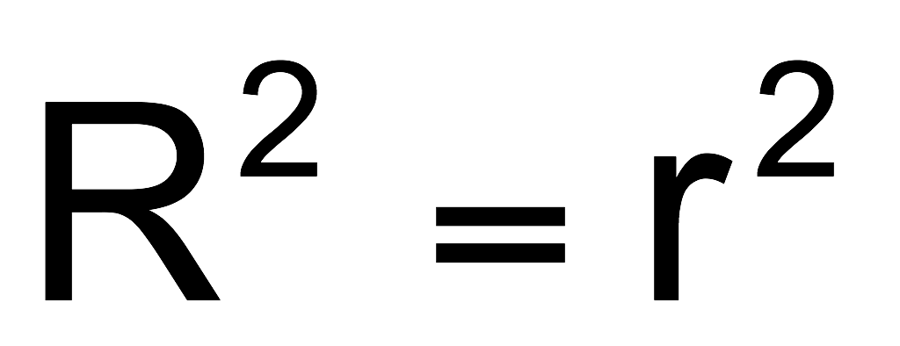
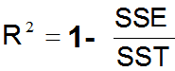
Coefficient of Determination (R²)
The coefficient of determination is the portion of the total variation in the dependent variable that is explained by variation in the independent variable
The coefficient of determination is also called R-squared and is denoted as R²
where
Note: In the single independent variable case, the coefficient of determination is
Where:
R2 = Coefficient of determination
r = Simple correlation coefficient
Note : It can also defined as
Ref:http://www.win-vector.com/blog/2011/11/correlation-and-r-squared/

Slide 31
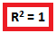
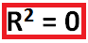
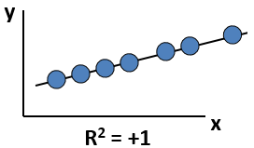
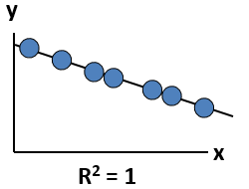
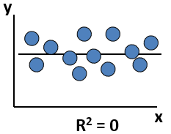
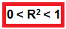
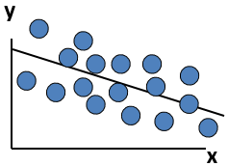
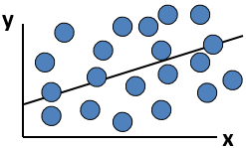
R² – Goodness of fit
R² , is called “goodness of Fit“ , which means it decides the model health .
Perfect linear relationship between x and y:
100% of the variation in y is explained by variation in x
No linear relationship between x and y:
The value of Y does not depend on x. (None of the variation in y is explained by variation in x)
Weaker linear relationship between x and y:
Some but not all of the variation in y is explained by variation in x

Slide 32
R² – Value : Intrerpretation
R-squared is always between 0 and 1 i.e. 0% and 100%, where:
0% indicates that the model explains none of the variability of the response data around its mean.
100% indicates that the model explains all the variability of the response data around its mean.
In general, the higher the R-squared, the better the model fits your data.

Slide 33
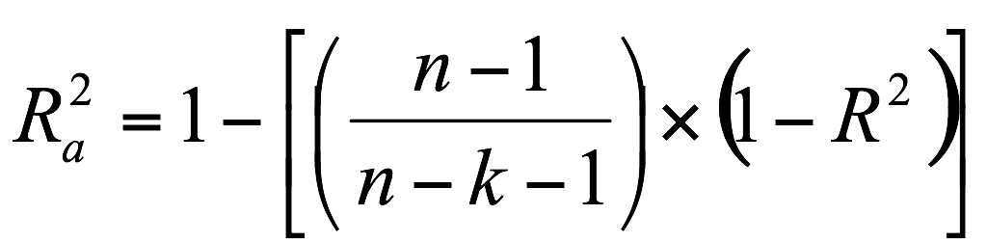
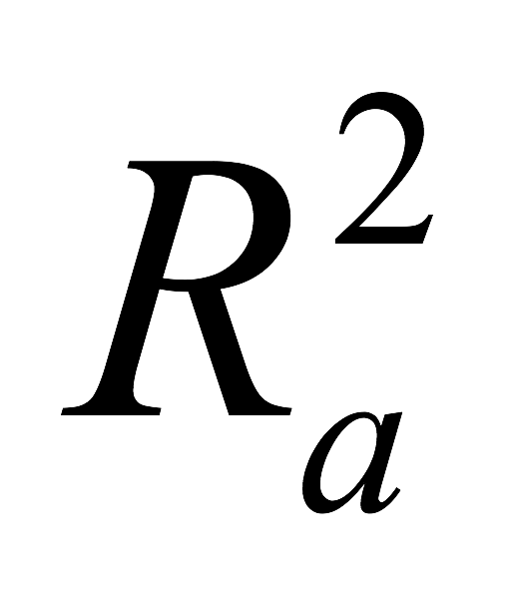
Adjusted R²
The drawback of using Coefficient of determination is that the value of the coefficient of determination always increases as the number of independent variables are increased even if the marginal contribution of the incoming variable is statistically insignificant.
To take care of the above drawback, coefficient of determination is adjusted for the number of independent variables taken. This adjusted measure of coefficient of determination is called adjusted R²
Adjusted R² is given by the following formula:
where
n = Number of Observations
k = Number of Independent Variables
= Adjusted R²
R-squared measures the proportion of the variation in your dependent variable (Y) explained by your independent variables (X) for a linear regression model. Adjusted R-squared adjusts the statistic based on the number of independent variables in the model.
The reason this is important is because you can "game" R-squared by adding more and more independent variables, irrespective of how well they are correlated to your dependent variable. Obviously, this isn't a desirable property of a goodness-of-fit statistic. Conversely, adjusted R-squared provides an adjustment to the R-squared statistic such that an independent variable that has a correlation to Y increases adjusted R-squared and any variable without a strong correlation will make adjusted R-squared decrease. That is the desired property of a goodness-of-fit statistic.
Ref : https://www.quora.com/What-is-the-difference-between-R-squared-and-Adjusted-R-squared

Slide 34
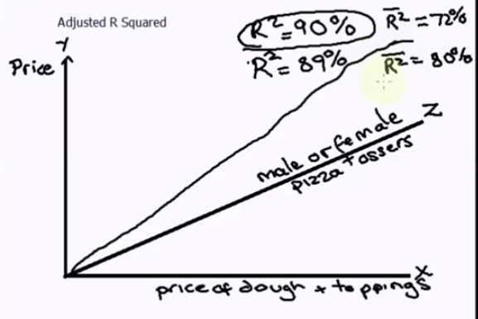
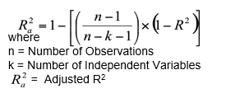
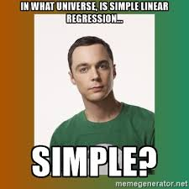
How to interpret it?
Ref: https://www.youtube.com/watch?v=KjRrdb2x6dA

Slide 35
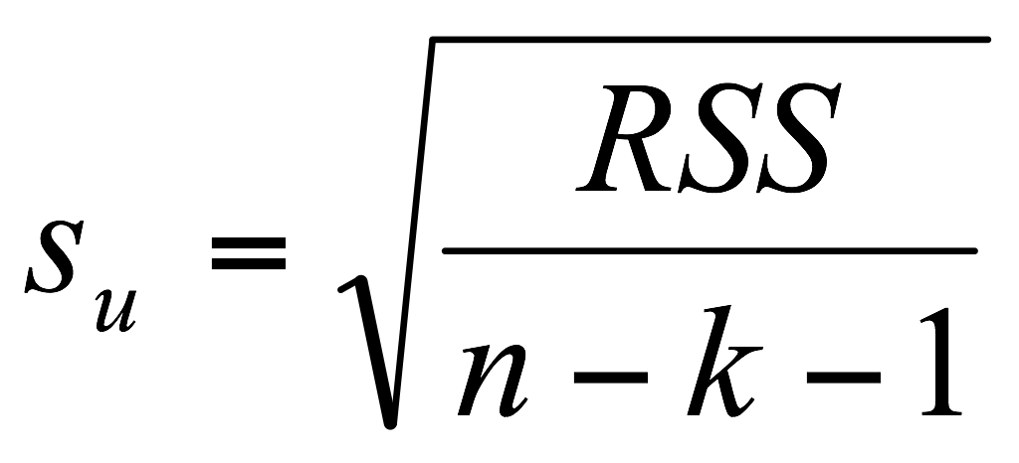
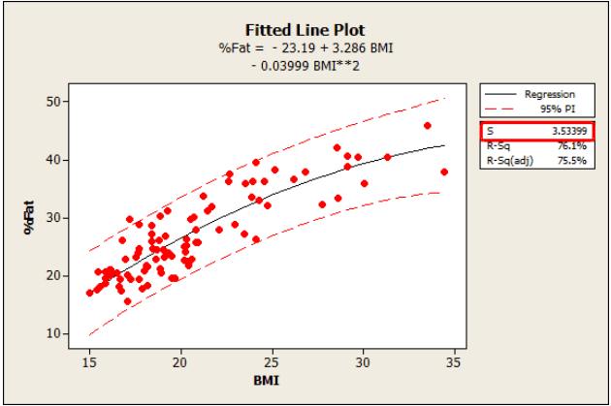
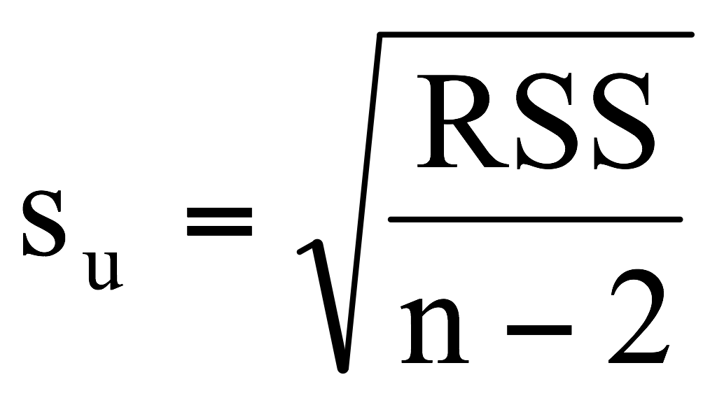
Standard Error of Estimate
The standard error of the estimate is a measure of the accuracy of predictions made with a regression line.
The standard deviation of the variation of observations around the regression line is estimated by:
How it is interpreted ?
S represents the average distance that the observed values fall from the regression line. Conveniently, it tells you how wrong the regression model is on average using the units of the response variable. Smaller values are better because it indicates that the observations are closer to the fitted line.
Where
RSS= Residual Sum of Squares
n = Sample size
k = number of independent variables in the model
Note: When k=1
= Sample standard error of the estimate
Note : In statistics, the residual sum of squares (RSS), also known as the sum of squared residuals (SSR) or the sum of squared errors of prediction (SSE), is the sum of the squares of residuals (deviations of predicted from actual empirical values of data).
The fitted line plot shown where BMI is used to predict body fat percentage. S is 3.53399, which tells us that the average distance of the data points from the fitted line is about 3.5% body fat.
Unlike R-squared, one can use the standard error of the regression to assess the precision of the predictions
Ref:http://blog.minitab.com/blog/adventures-in-statistics/regression-analysis-how-to-interpret-s-the-standard-error-of-the-regression

Slide 36
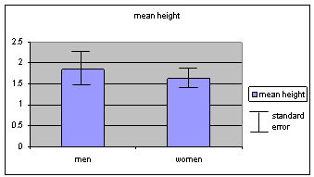
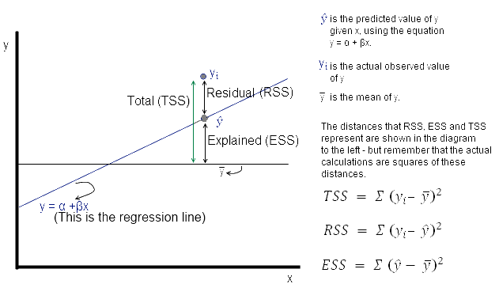
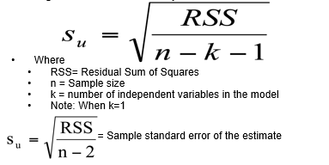
Interpretation
https://www.youtube.com/watch?v=BwYj69LAQOI

Slide 37
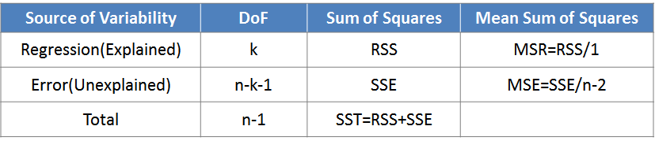
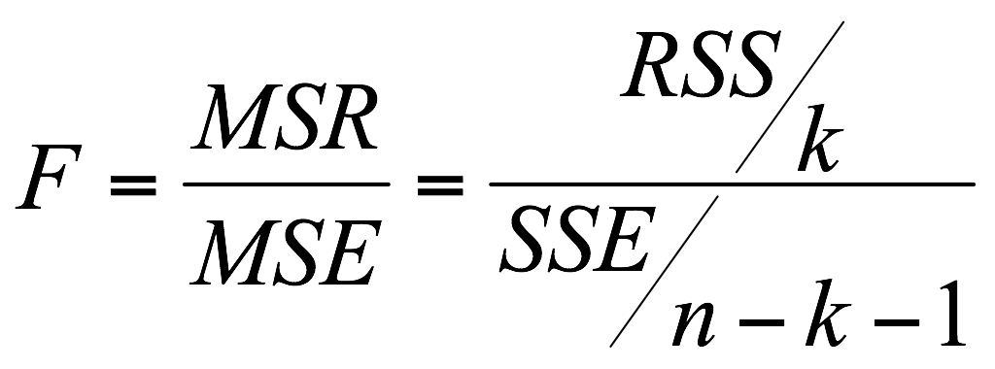
F Test - ANOVA (Revisit)
A typical ANOVA table looks like:
An F-test explains how well the dependent variable is explained by the independent variables collectively.
In case of multiple independent variable, F-test tells us whether a single variable explains a significant part of the variation in dependent variable or all the independent variables explain the variability collectively.
F-statistic is given as:
Where:
MSR: Mean Regression sum of squares
MSE: Mean Squared Error
n: Number of observations
k: Number of independent variables

Slide 38
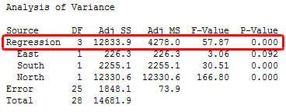
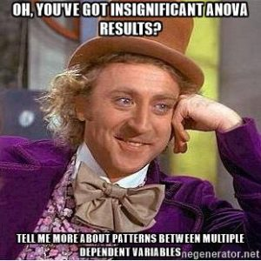
ANOVA interpretation
A regression model that contains no predictors is also known as an intercept-only model.
Null hypothesis: The fit of the intercept-only model and your model are equal.
If the P value for the F-test of overall significance test is less than your significance level, you can reject the null-hypothesis and conclude that your model provides a better fit than the intercept-only model.
http://blog.minitab.com/blog/adventures-in-statistics-2/what-is-the-f-test-of-overall-significance-in-regression-analysis

Slide 39
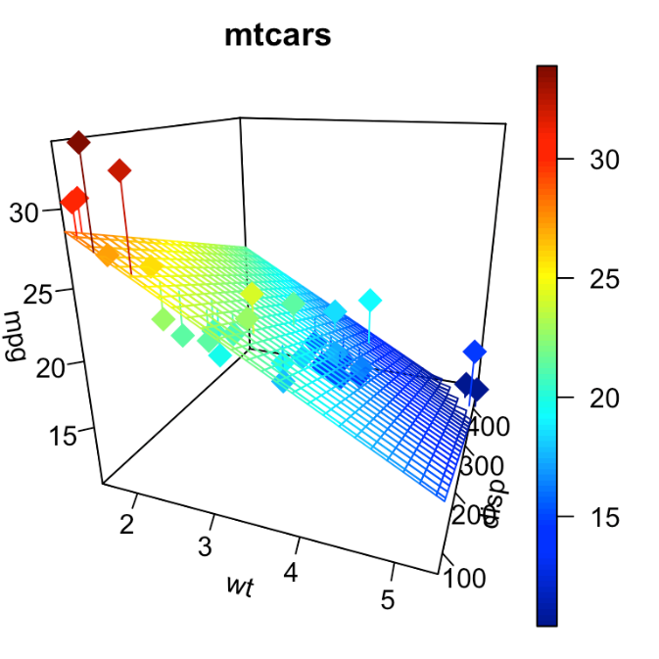
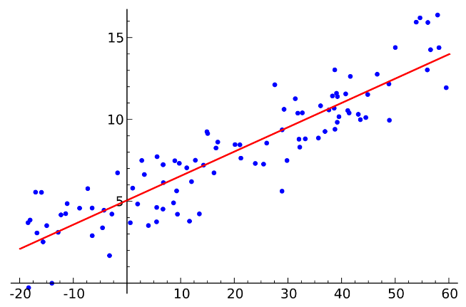
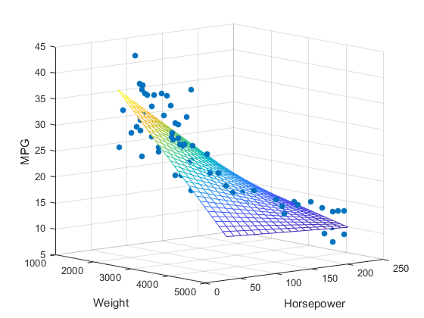
Visual representation
2D
3D
3D

Slide 40
USE CASE
Sl.No# | Topics | Reference | Note
1 | Linear Regressiion -1 | https://techtime.accenture.com/document/predicting-used-car-prices-part-i | Lessons on Data Extraplotation
2 | Linear Regressiion -2 | https://techtime.accenture.com/document/predicting-used-car-prices-part-ii | Lessons on Linear Regression

Slide 41

Thank You

Slide 42
